Slide 1


BUSINESS INFORMATION
SYSTEMS - CSE4003
GROUP PRESENTATION
Samarakoon Mudiyanselage Tharindu Francesco CL/HDCSE/CMU/131/17 st20339052
Hingurage Ravindu Shenal Perera CL/HDCSE/CMU/131/28 st20338940
Dunukara Mudiyanselage Sithumi Amaya CL/HDCSE/CMU/131/14 st20339049
Sahan Kavishka Adhikari CL/HDCSE/CMU/131/32 st20338943
Randyn Shalinka Mario Uyanage CL/HDCSE/CMU/131/27 st20338939

Slide 2
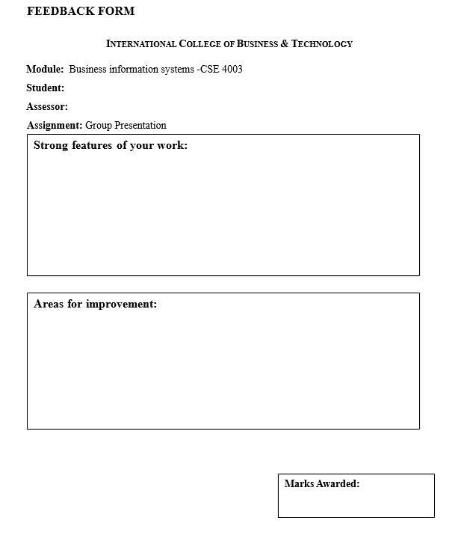
Randyn Shalinka Mario Uyanage CL/HDCSE/CMU/131/27

Slide 3
Table of contents
Feedback form…………………………………………………………………………………………………………………………………………………………….2
Improving the Performance and Customer Satisfaction in Pizza Hut of Sri Lanka …………………………………………………………5
Competitive advantage of Information Systems…………………………………………………………………………………………....6
General picture of the Food Preparation Department…………………………………………………………………………....7
Optimization of Food Delivery Tasks……………………………………………………………………………………………………8
To Enhance Customer Service in Pizza Hut Sri Lanka………………………………………………………………………….....9
Inventory Management optimization in Pizza Hut Sri Lanka………………………………………………....................................10
Quality control, quality assurance strategies and strategies to ensure hygiene……………………………….………………….11
Role of Human Resources Department Functions………………………………………………………………………………………….12
Description of the Role of Finance Department………………………………………………………………………………………………13
Profile of Pizza Hut Sri Lanka IT Department operations…………………………………………………………………………………..14
Operation Excellence- Administration Department…………………………………………………………………………………………15
Types of Information System in Pizza Hut………………………………………………………………………………………………......... 16
Knowledge of Decision Support System and ERP Solutions………………………………………………………………………….......17
Fast Food Competitive Landscape: A comparison of Information systems………………………………………………………..…18
The New Trends in Fast Food Industry…………………………………………………………………………………………………...………19
Summary ………………………………………………………………………………………………………………………………………….20
Contribution Report……………………………………………………………………………………………………………………………21
Thank you …………………………………………………………………………………………………………………………………………22
References ………………………………………………………………………………………………………………………………………23

Slide 4
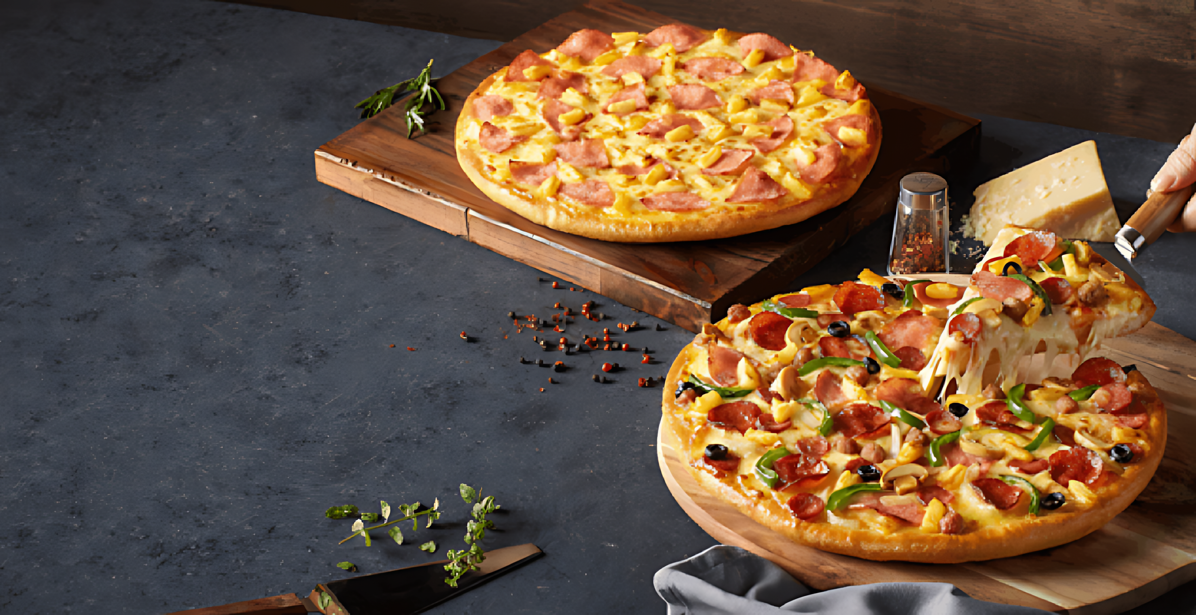

Pizza Hut
Information Systems for Operational Efficiency & Customer Satisfaction – The Pizza Hut Case

Slide 5
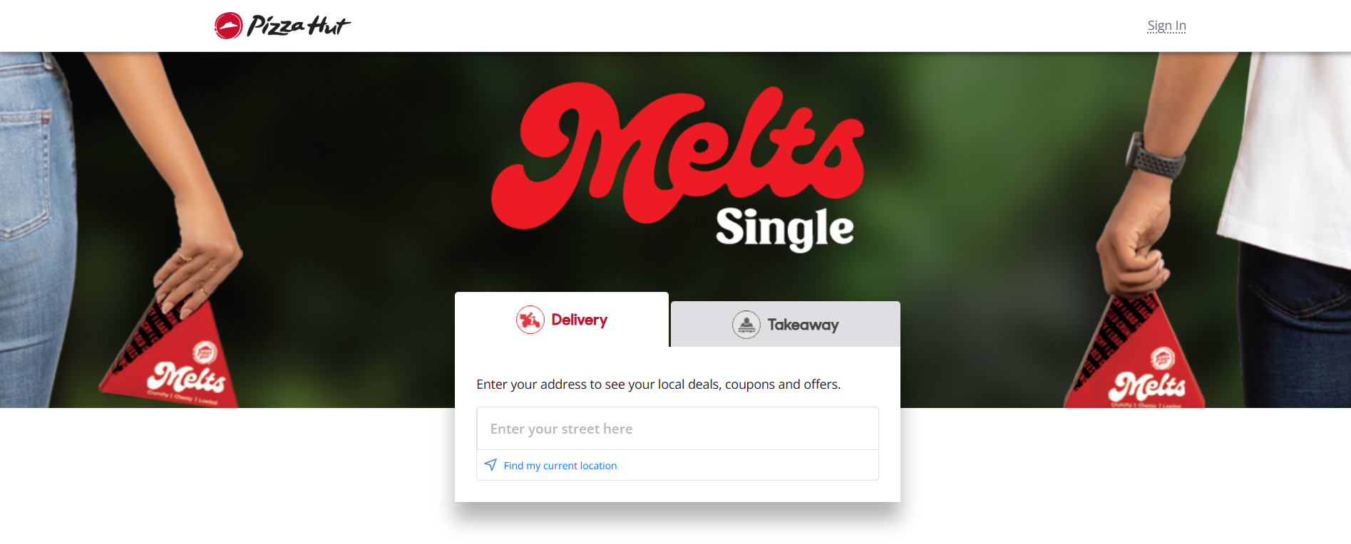

Improving the Performance and Customer Satisfaction in Pizza Hut of Sri Lanka
This presentation goes into detail regarding how information systems are critical in streamlining operations, customer satisfaction at Pizza Hut Sri Lanka (preparing, marketing, finance, etc.) in addition to practically how this can be improved.

Slide 6

Competitive advantage of Information Systems
An in-depth examination of the Pizza Hut Sri Lanka incorporating the use of digital processes to boost operation efficiency and to achieve the objectives of technology-business strategy integration.

Slide 7




General picture of the Food Preparation Department
Learning how food preparation is vital in terms of quality and customer satisfaction.
Superior Quality Food
Assurance of Taste
They make sure food served is of quality.
Concentrates in improving the taste of foods.
Management of Stocks
Schedules for Preparation
Monitors stock to prevent out of stocks.
Schedules dining in order to maximize time.

Slide 8




Optimization of Food Delivery Tasks
On time delivery of food
Order tracking in real time
Makes customers more convenient.
Makes delivery processes efficient.
Making life easier to customers by having a good delivery system and tracking of the order on real time basis
Customer satisfaction focus
Efficient administration of the logistics
Putting the needs of the consumers first.
Facilitates the process of delivery.

Slide 9
To Enhance Customer Service in Pizza Hut Sri Lanka
The improvement of quality services by the ability to access information and be responsive.
Handling of Customer Queries
The unit highly responds to customer queries in order to improve customer satisfaction and loyalty.
Management of Feedback
Gathering and evaluating customers ideas about how to better the services provided and the total experience.
Access to Order History
When it comes to personal service, quick complaints resolution requires the ability to look into customer order history.
Resolution of Complaints
Swiftly resolving issues such as customer complaints that will help to regain customer satisfaction and confidence on the service.
Improvement of Quality
Using the comments given by customers and order information to constantly increase the service level at Pizza Hut.
Building Loyalty
Using customer-based strategies to enable customer loyalty and repeat business.

Slide 10
Inventory Management optimization in Pizza Hut Sri Lanka
Learning how inventory management is necessary to increase the efficiency of food supply and resource allocation.
1
Management of the Food Supply
The Inventory Management Department has the responsibility of managing the food supplies in order to ensure efficiency in the running of the operations. It guarantees the availability of all the required ingredients that are needed depending on the demand made by the customers without overstocking in an inventory.
2
Efficiency in Operations
The department contributes very nice to the efficiency of operations by offering good inventory management services. This will entail ordering and tracking of supplies promptly to eliminate inconveniences in the service delivery.
3
Needs of information Supplier Information
The department will need correct information about suppliers so as to make the right decisions in regards to purchase. This will accommodate the information on the delivery schedules, prices, and quality of supplies in order to have dependable operations.
4
Preventing Shortages
The department should record the inventory levels constantly to prevent shortages. Such a proactive strategy can assist in resource management and the elimination of obstacles to the provision of food in Pizza Hut.
5
Management of Resources
Appropriate management of resources by the department would mean that materials needed in operations are in place and wastage is reduced. This is important in upholding quality of services offered to the customers.

Slide 11
Quality control, quality assurance strategies and strategies to ensure hygiene
maintains standards for food safety and quality.
Checks quality and hygiene reports needed
The Quality Control and Hygiene Assurance Department is mandated with the role of ensuring that the food safety standards and quality backing of the food products is effective so as to safeguard the health of the consumers and the reputation of the brand.
The department should cover health standards and protect the reputation of the brand, so quality checks and hygiene reports should be regular with information on the food handling practices and cleanliness.
Food safety and hygiene provision to customer satisfaction

Slide 12
Main HR Functional Area
Hiring and training of staff are major activities carried out by the Human Resources Department that would guarantee the organization to have qualified personnel. This is a requirement to ensure efficiency of operations.
Role of Human Resources Department Functions
Information Requirements
In order to ensure efficient management of employees and operations, the HR must have access to staff records and training records. It is this information that is important in monitoring performance and future staffing needs.
Contribution on staff development
The HR department, besides recruiting, also makes central contributions to the training and learning of the employees so that they have the proper skills to work their jobs well.
The workplace at the Pizza Hut Sri Lanka The roles and information requirements of HR at the Pizza Hut Sri Lanka
Effect on Business Functions
Smooth organizational of hiring and training by the HR department has a direct influence on efficientness and success of the overall work of Pizza Hut Sri Lanka that results in the improvement of service delivery.

Slide 13
Description of the Role of Finance Department
Financial inflows Management
Financial Outflows Tracking
Monitors and follows every incoming money.
Monitors and checks all expenditure made out.
Knowledge development of financial monitoring and information requirements of good management
Transaction Information requirements
Requirements of Budget Information
It needs elaborate transactional records to be analyzed.
Basing on budget data to prepare financial plans.

Slide 14
Pizza Hut marketing strategies
The brief about the role of the marketing department and information needs
1
Strategies for Promotion
The Marketing Department concentrates on the effectiveness of the promotion of the Pizza Hut menu so that all promotion materials could correspond to the customer preferences and tendencies.
2
Customer Feedback
The department focuses on the significance of the customer feedback in order to customize marketing campaigns. The information is useful in modifying approaches that favor customer expectations and perceptions.
3
Trends in the Market
Market trends are very essential to develop the relevant advertisement strategies. The department produces a constant analysis of data to keep up with the competition in the fast-food market.
4
Successful Campaigns
Based on collected data, the marketing unit designs effective campaigns that are aiming at reaching a wider audience and increasing the number of customers interacting with the brand directly.
5
Growth in Sales
The mission of the department is, in its turn, to catalyze the growth of sales, using creative marketing methods which will emphasize what is special about the menu items offered by Pizza Hut.

Slide 15
Profile of Pizza Hut Sri Lanka IT Department operations
Among operational efficiency needs are the knowledge of functional areas and the information requirements.
1
Communication systems management
The IT department involves the management of order and communication systems so that all activities are efficiently and effectively carried out so as to improve on service delivery.
2
Concentrate on efficiency of operations
With the efficiency of the processes, IT department would play a key role in safeguarding the operational efficiency which is critical in the dynamic environment of Pizza Hut.
3
Critical information requirements
The department needs information system performance and security data to maintain high performance in its operations since such information is needed in monitoring and enhancing operational integrity.
4
Keeping the system performance in check
The ability to monitor the performance of systems can help the IT department spot the problem early and rectify it, hence reducing downtimes and improving user experience.
5
Upholding security procedures
The IT section gives priority on data on security so that the systems are not at risk of threats hence providing security to sensitive data at Pizza Hut.

Slide 16
Operation Excellence- Administration Department
Easy functioning processes
This eliminates ineffectiveness in outlets.
Requirement in terms of outlet reports
Required to make informed decision.
Successful management of schedules
Makes timely coordination easier.
coordination between various outlets
Promotes internal communications.
Ensuring smooth processes and good coordination of outlets
supervision by management
Facilitates strategic decision making..
Data operated operations
Makes use of reports in the form of improvements.

Slide 17
Types of Information System in Pizza Hut
Transaction Processing System (TPS)
manages day to day transactions.
Management Information System (MIS)
Gives decision making summaries.
Customer Relationship Management (CRM)
Investigating the most important systems that can benefit the work and interaction with customers
It handles customer data as a form of customer loyalty and service advancement.

Slide 18
Decision Support System (DSS)
A regime that helps one make intricate decisions based on the examination of information efficiently.
Knowledge of Decision Support System and ERP Solutions
Purpose of DSS
Helps in decision-making due to the analyzing of data which overall makes decision making more effective.
Enterprise Resource Planning (ERP)
combines multiple business functions into different system in order to manage them better.
Learning the key aspects of how DSS and ERP helps in improving the business operations and the decision making process
Benefits of ERP
Provides smooth operations because it networked various business processes and Data.
DSS and ERP Collaboration
Blending DSS and ERP enables the development of superior decision making-capacity throughout the departments.

Slide 19


Fast Food Competitive Landscape:
A comparison of Information systems
Analysis of the use of technology in Pizza Hut, Domino and KFC as a source of competitiveness
Pizza Hut
Domino's and KFC
It uses powerful information systems.
Provides order online service.
Offers mobility in terms of loyalty programs to clients.
Use information systems of higher level to increase service.
Has an online order tracking system and GPS.
Use mobile customer loyalty programs Regarding customer engagement.

Slide 20
The New Trends in Fast Food Industry
Discovering the main trends shaping the innovative and sustainable solutions in fast food industry..
Digitalization
AI Analytics
Food Automation
Sustainable Packaging
Use of technology to improve customer experience and make operations smoother is vital in the fast-food industry.
Predictive analytics with the help of AI can help a business learn the preferences of the customers and make the service more efficient.
The automation of food manufacturing minimizes the cost of labor, as well maximizes on consistency and speed of the processes involved in preparing of meals.
The key to sustainability packaging is adopting the ability to reduce the effect on the environment and attracting conscientious consumers.

Slide 21
Summary
This case study of Pizza Hut Sri Lanka gives an example of how Business Information Systems (BIS) play a critical role towards ensuring operational excellence and customer-focused service. By implementing a digital solution in all of its departments, i. e. food preparation and delivery, HR, marketing, and finance, Pizza Hut enhances the quality of its services, increases customer loyalty and sustains quality.
Also, data-driven decision and simplified functioning are accomplished through the integration of sophisticated systems, such as TPS, MIS, CRM, DSS, and ERP. The dynamic nature of the fast food business makes it hard to sustain its position, which however, would be guaranteed by the active role played by Pizza Hut on the use of technology and being innovative.

Slide 22
Contribution Report
Group Title:
Business Information Systems – Pizza Hut Sri Lanka
Course Code:
CSE4003
Name | Index Number | Contribution
Tharindu Francesco Samarakoon | CL/HDCSE/CMU/131/17 (st20339052) | Developed and prepared requirements related to the functions of the Food Preparation Department and the information needed by the department. Power point presentations on quality control.
Ravindu Shenal Perera | CL/HDCSE/CMU/131/28 (st20338940) | Indicated with the Delivery System on optimization. Assisted in examining and generating the information about real-time tracking and efficiency in the logistics.
Sithumi Amaya Dunukara | CL/HDCSE/CMU/131/14 (st20339049) | Prepared the slides connected to HR department and its effects on training, performance and data requirement. Manufactured the style and consistency of visual presentation.
Sahan Kavishka Adhikari | CL/HDCSE/CMU/131/32 (st20338943) | Author of the Finance sections and Marketing with the specialization on subject of financial monitoring systems and marketing trends.
Randyn Shalinka Mario Uyanage | CL/HDCSE/CMU/131/27 (st20338939) | Carried out the analysis of the IT and Administration Departments as well as type of Information Systems (TPS, MIS, CRM). Comparisons in industry trends and DSS/ERP worked on

Slide 23
Thank you !

Slide 24
Refences
Scienter Technologies (Pte) Ltd (2019). Home | Order Pizza Online - Delivery‎ or Pickup. [online] Pizzahut.lk. Available at: https://www.pizzahut.lk/.
Statista (2024). The statistics portal for market data, market research and market studies. [online] Statista.com. Available at: https://www.statista.com/.
‌
National Restaurant Association (2022). National Restaurant Association. [online] National Restaurant Association. Available at: https://restaurant.org/.
‌
World Health Organization (2024). Food safety. [online] Who.int. Available at: https://www.who.int/news-room/fact-sheets/detail/food-safety.
‌
‌

